Slide 1
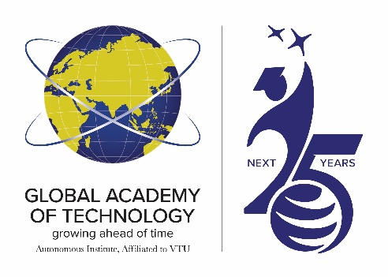

GLOBAL ACADEMY OF TECHNOLOGY
Affiliated to VTU, Recognized by GOK, Approved by AICTE
Aditya Layout, Ideal Homes Bengaluru - 560 098 www.gat.ac.in
DEPARTMENT OF ARTIFICIAL INTELLIGENCE AND DATA SCIENCE
MINI PROJECT FINAL REVIEW
ADSP23506
The Dynamics of India’s GDP: Measuring Progress and Potential
Under the guidance of : Prof. Gargi.N
Presented By :Ravi C,USN:1GA23AD042
Vishwaradhya H,USN:1GA23AD060

Slide 2
CONTENTS
INTRODUCTION
LITERATURE SURVEY
PROBLEM STATEMENT
OBJECTIVES
METHODOLOGY
RESULTS & DISCUSSIONS
CONCLUSION
REFERENCES

Slide 3
INTRODUCTION
GDP reflects India’s overall economic performance and structural transformation.
The economy has shifted from agriculture to industry and services, driven by reforms and globalization.
Despite growth, unemployment, inequality, and inflation remain major challenges
AI and data analytics now enhance GDP forecasting and policy planning..
Government initiatives like Make in India and Digital India aim to boost self-reliance and industrial growth.
External shocks (COVID-19, global tensions) impact economic stability and recovery.
The study focuses on analyzing GDP trends, identifying key growth drivers, and promoting sustainable, inclusive development
This outcomes aims to analyze India’s GDP trends, determine key determinants of growth, and develop data-driven forecasting models for sustainable and inclusive development.

Slide 4
LITERATURE SURVEY
Paper No. | Methodology | Features | Title And Author | Advantages | Disadvantages
[1] | ARIMA (Auto Regressive Integrated Moving Average) | GDP growth rate | B. Muma & A. Karoki | Good for short-term GDP forecasting with seasonal adjustments | Poor in handling nonlinear policy shocks
[2] | Multiple Linear Regression . | Agriculture, industry, ser- vices, investment, consumption | M. D. Adewale etal | Simple and interpretable; shows contribution of each sector . | shows contribution of each sector Limited predictive accuracy with multicollinearity
[3] | VAR (Vector Auto regression) | GDP, inflation | M. Y. Shams, Z. Tarek | Captures macro-variable interlinkages and causality | Requires stationarity; sensitive to lag selection
[4] | Machine Learning Regression | employment, imports, policy rate | J. Yoon | Handles nonlinear patterns strong forecasting accuracy | Less interpretable; requires large data

Slide 5
LITERATURE SURVEY
Paper No. | Methodology | Features | Title And Author | Advantages | Disadvantages
[5] | Support Vector Regression | GDP, inflation, interest rate, remittances | B. Muma & A. Karoki | Good for short-term GDP forecasting with seasonal adjustments | Poor in handling nonlinear policy shocks
[6] | Bayesian Structural Time Series | GDP, global commodity index, policy dummies | Bheemanna & M. N. Megeri | Probabilistic output with uncertainty intervals | Computationally intensive
[7] | Panel Data Regression | GDP, inflation | B. Ioan | Captures macro-variable interlinkages and causality | Requires stationarity; sensitive to lag selection
[8] | Input–Output Analysis | Agriculture, industry, ser- vices, exports, energy in- put | P. Munjal | Quantifies sectoral contribution and linkages | Static; cannot forecast future shocks

Slide 6
PROBLEM STATEMENT
India’s economy has experienced remarkable growth over the past few decades, reflecting significant progress across various sectors. However, despite this strong expansion, persistent challenges such as unemployment, income inequality, inflation, and heavy dependence on external trade continue to influence economic stability. Although the government has implemented numerous reforms and policy measures, questions remain about whether this growth is truly sustainable and inclusive for all segments of society. Therefore, analyzing India’s Gross Domestic Product (GDP) becomes essential to understand how key sectors—agriculture, industry, and services—contribute to the nation’s overall performance. This study also seeks to identify the main drivers of economic growth while examining factors that may hinder long-term stability. Ultimately, the aim is to provide a clearer, more comprehensive view of how balanced and resilient India’s economic progress really is.

Slide 7
PROBLEM OBJECTIVES
To analyze India’s Gross Domestic Product (GDP) and assess the overall pattern of economic growth over the past decades.
To evaluate the contribution of major sectors such as agriculture, industry, and services to India’s GDP..
To identify key growth drivers that have influenced India’s economic expansion..
To examine major challenges like unemployment, income inequality, inflation, and dependence on external trade.
To highlight factors that may gives long-term economic stability and balanced development.

Slide 8
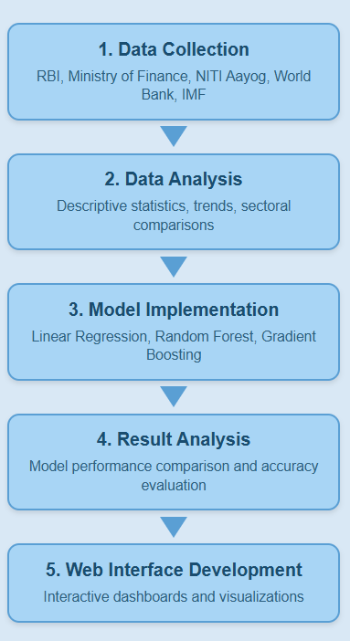
METHODOLOGY
1. Data Collection:
Gather data from RBI, Ministry of Finance, NITI Aayog, World Bank, IMF, and Economic Surveys.
Include GDP growth rates, sectoral data (agriculture, industry, services), inflation, unemployment,
and trade.
2. Data Analysis:
Use descriptive statistics to find trends and patterns.
Compare sectoral contributions and policy effects across time.
3. Model Implementation:
1.Linear Regression:It assumes a straight-line relationship between the input (Year) and the
output (GDP)
2. Random Forest Regressor:Uses multiple decision trees and averages their predictions to handle
complex, non-linear GDP patterns
3. Gradient Boosting Regressor:It adds trees step by step, each improving the model by correcting
earlier prediction error
4. Result Analysis
The Linear Regression model captured the overall GDP growth trend but missed nonlinear variations.
Random Forest improved prediction accuracy by handling complex patterns and reducing noise.
Gradient Boosting achieved the best results by sequentially correcting errors, providing the most precise GDP forecasts.
5. Web Interface (Webface) Development
Design a user-friendly web interface (using tools like Flask, or React) to visualize and
interact with GDP analysis results.
Include interactive charts, filters, and dashboards for real-time exploration of sectoral and policy
impacts.

Slide 9
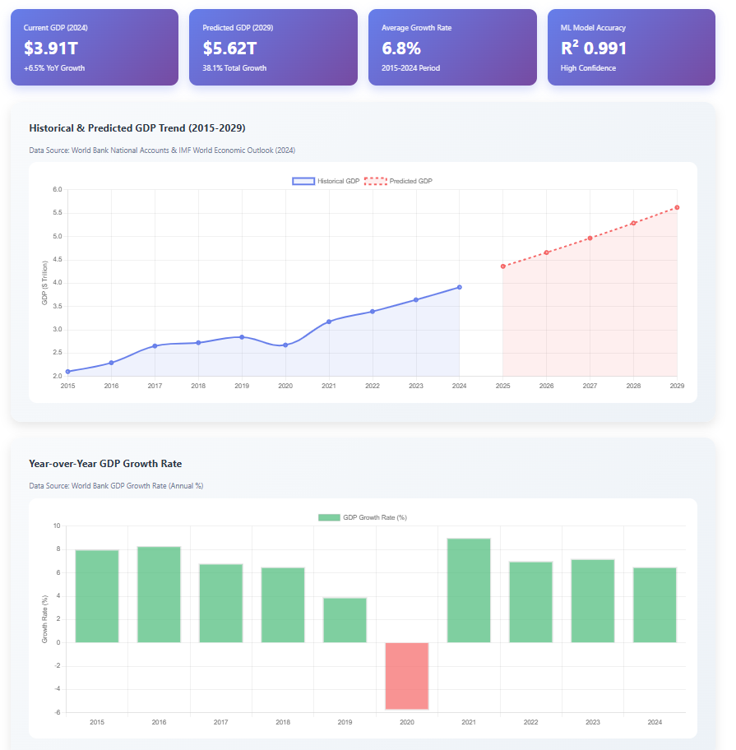
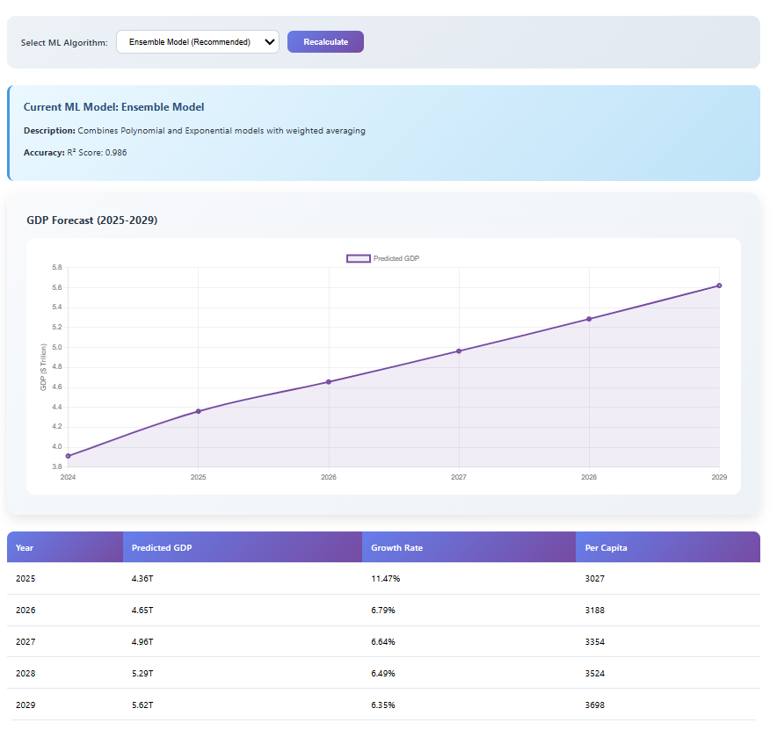
RESULTS

Slide 10
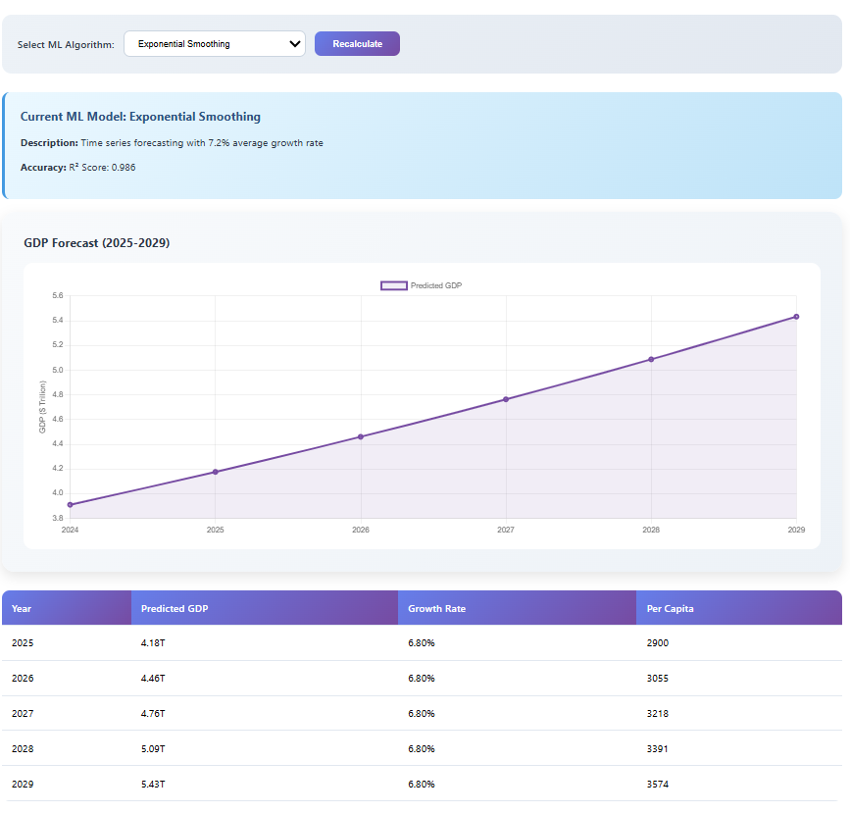
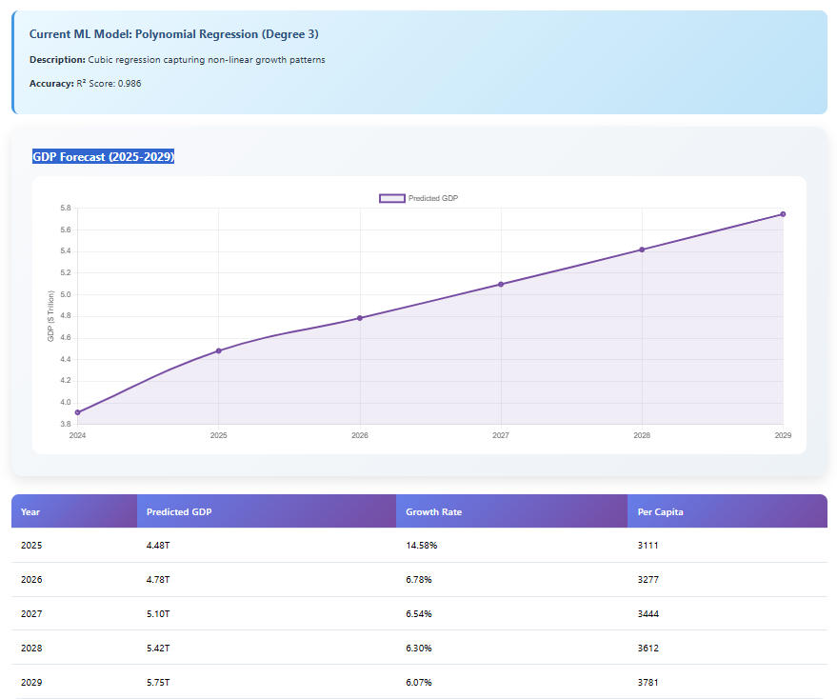

Slide 11
CONCLUSION
1.India’s economy has shown strong growth over the past decades, yet structural challenges such as unemployment, inequality, and inflation continue to impact long-term progress.
2.The sectoral analysis highlights how agriculture, industry, and services each play a vital role in shaping overall GDP trends.
3.Combining quantitative data with qualitative insights provides a clearer understanding of the country’s economic strengths and weaknesses.
4.The findings underline the importance of sustainable, inclusive, and innovation-driven growth policies to ensure balanced development.
5.The developed web-based interface (Webface) makes the results interactive, transparent, and accessible, supporting better decision-making for policymakers and researchers.
6.Overall, this study contributes toward building a resilient and future-ready Indian economy.

Slide 12
REFERENCES
[1] ARIMA / SARIMA: B. Muma & A. Karoki, “Modeling GDP Using Autoregressive Integrated Moving Average (ARIMA) Model: A Systematic Review”, Open Access Library Journal, Vol 9 No 4 (2022).
[2] Machine Learning Regression (Random Forest, XG Boost): M. D. Adewale et al., “Predicting Gross Domestic Product using the ensemble: Random Forest, XG Boost…”, ScienceDirect (2024).
[3] LSTM / RNN / Neural Networks: M. Y. Shams, Z. Tarek, M. M. Eid et al., “Predicting Gross Domestic Product (GDP) using a PC-LSTM-RNN model in urban profiling areas”, Springer, 2024.
[4] Multiple Linear Regression / Machine Learning for GDP: J. Yoon, “Forecasting of Real GDP Growth Using Machine Learning Models: Gradient Boosting and Random Forest Approach”, Compute Econ, 57, 247-265 (2021)
[5] Hybrid ARIMA–ANN Model: Published as “A Hybrid Forecasting Structure Based on ARIMA and Artificial Neural Network” in Applied Sciences 14(16):7122 (2024).
[6] Support Vector Regression (SVR) for GDP / macro-forecasting: Published as “Unemployment rate and GDP prediction using support vector regression” by (names omitted in summary) (ACM, 2019).

